Slide 1
Survey on Recommendation System for Movies using Content Based Filtering and Collaborative Filtering
Geeta Munjal(19MCA0147) Madhurima Chakraborty(19MCA0087) Pragya Yadav(19MCA00125)

Slide 2
01
Intuition
Contents
02
Objective
03
Related Works
04
Content Based Filtering
05
Collaborative Filtering
06
Evaluation
07
Algorithms used
08
Conclusion

Slide 3
Intuition

Slide 4

Recommendation
System
A recommendation engine is a tool that predicts suggestions of a list of items, to the users, based on the items that they may like or prefer. The items may be movies, books, songs etc.

Slide 5
Objective

Slide 6
Objective
As we are aware that there are many approaches to a recommendation system. We are surveying two of the approaches :- content based and collaborative filtering. Also we are measuring the accuracy of the same.
60%

Slide 7
Related Works

Slide 8
Related Works
PAPER
YEAR
CONTENT
Content –Based Movie Recommendation System Using Genre Correlation | 2019 | In this paper the author has been recommending movies according to their genres. The used methodology is content-based filtering by genre correlation.
Content-based Video Recommendation System based on Stylistic Visual Features | 2019 | Here theyfocuses on video recommendation system. It automatically evaluates the content of video and abstract some features uses a method Applied Media Theory.
A Fast Content-Based Recommendation System for Scientific Publications | 2016 | Here they recommended the scientific papers.it suggested the paper based on user rating or likes.LSA algorithm used to suggest the no of component. Rocchio Algorithm is used to classify the relevant and non-relevant document.
Survey on Content Based Recommendation System | 2019 | Here author shares about the importance of recommendation system and perform a comparative study on it. They combine two methods and perform in it. They use content with collaborative filtering and collaborative with demographics and so on.

Slide 9
Related Works
PAPER
YEAR
CONTENT
A Content-Based Recommendation System Using Neuro-Fuzzy Approach | 2016 | It simulates and learn the possibility of users vast on their pervious actives. The two approaches are applied in this paper which is neuro fuzzy and deep learning
Improvised Book Recommendation System Based on Combine Features of Content Based Filtering, Collaborative Filtering and Association Rule Mining | 2016 | This paper , focuses on marketing and sales using the improvised recommendation system. It performs to gives the high customer satisfaction. The two methodology is used in this system is collaborative and content to get the latest trends in the market.
Using Collaborative Filtering Algorithms Combined with Doc2Vec for Movie Recommendation | 2019 | The authors have offered recommendation system based on Doc2Vec model. This model converts the textual document in the form of numbers. The model analyses the document by it’s semantics and converts into a vector. The Vector is then used in collaborative filtering.

Slide 10
Content Based Filtering

Slide 11
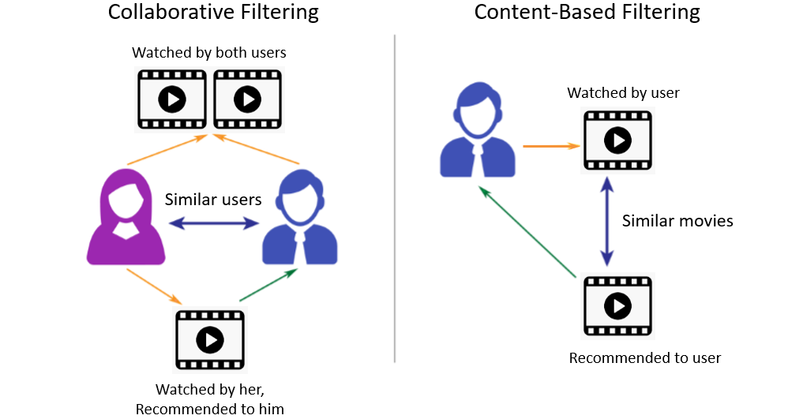
Content Based Filtering
Content Based Filtering
In this movie recommendation system approach, we aim to suggest the movies best suited to the user’s preferences.
Based On User’s Interest

Slide 12
Architecture
Recommend movies to user
Compare with user’s movie and sort in descending order
Find Count vectorise and cosine similarities
Features Selection and Extraction
Dataset Preprocessing
Dataset Extraction

Slide 13
Collaborative Filtering

Slide 14
Collaborative Filtering
Item-to-item Collaborative Filtering
Collaborative filtering is a technique that can filter out items that a user might like on the basis of reactions by similar users. It works by searching a large group of people and finding a smaller set of users with tastes similar to a particular user
Based on Similar Ratings

Slide 15
Architecture
Recommend movies to user
Compare with user’s movie
Find cosine similarity on the basis of ratings
Dataset Preprocessing
Dataset Extraction

Slide 16
Evaluation

Slide 17
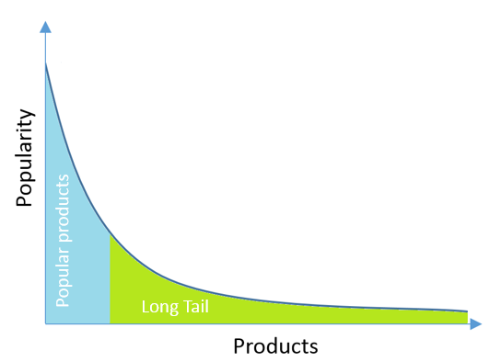
Evaluation
The item-to-item approach of collaborative filtering is being evaluated to check the accuracy of the recommendation system. For evaluation purposed we have taken up the RMSE and MSE methods.
Long Tail Plot
We have visualized the popular movies on the basis of film ratings using the long tail graph.
Surprise package and SVD
This package is present in scikit of Python language. It will help us in the analysis of our recommendation system. This is a technique used to shrink the dataset, that is used in machine learning for reducing features
Root Mean Squared Error
Root mean squared error or RMSE is a standard approach to evaluate our model.
RMSE | 0.407421597085228
MSE | 0.1659923577714779

Slide 18
Algorithms

Slide 19
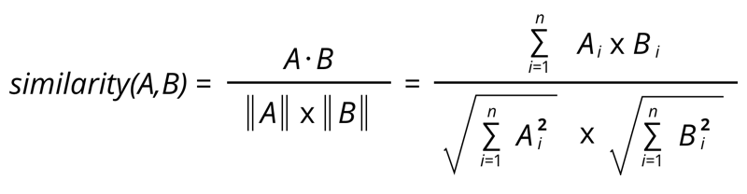
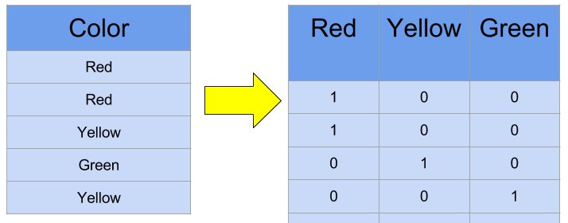
Cosine Similarity
Cosine similarity is a measure that is used to find the similarity between two components regardless of their sizes
Count Vectorization is a metric that refers to counting the number of times a word has occurred in the text. This is one of the elementary ways of representing textual data in the form of numbers.
Count Vectorization

Slide 20


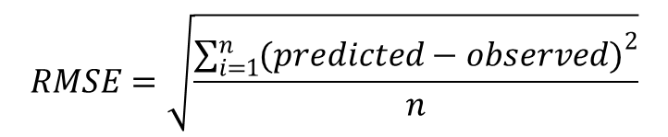
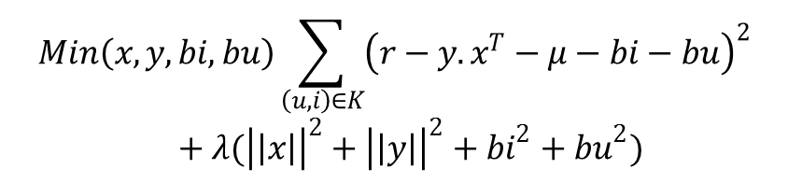
SVD
$$A=USV^{T}$$
This is a technique used to shrink the dataset, that is used in machine learning for reducing features. In context of CF , a matrix of dimensions user x items is used. Matrix is reduces in accordance with the above relation
$$Min\left(x,y,bi,bu\right)\sum_{\left(u,i\right)∈K}{{\left(r−{y.x}^{T}−μ−bi−bu\right)}^{2}}+λ({\left|\left|x\right|\right|}^{2}+{\left|\left|y\right|\right|}^{2}+{bi}^{2}+{bu}^{2})$$
An RMSE between 0.2 to 0.5 is considered good result. We have set a constraint that rating>=4 would be taken up for evaluation, which is giving us an RMSE $≅$ 0.4
RMSE
$$RMSE=\sqrt{\frac{\sum_{i=1}^{n}{{(predicted−observed)}^{2}}}{n}}$$

Slide 21
Conclusion

Slide 22
Conclusion
From the experimental setups , we understand that in a CBF recommender system, the individuals previous choices are taken in account. It is totally relying upon the features of the movie. CF is based completely on peer rating for the same movie.
60%

Slide 23
THANK YOU

